Slide 1

NT101-Network Security
Week 01 Network Security Overview
Ngoc-Tu Nguyen, PhD
tunn@uit.edu.vn

Slide 2
Outline
Motivations
Threat, vulnerability, risk
Comment attacks
Protection, detection and response

Slide 3
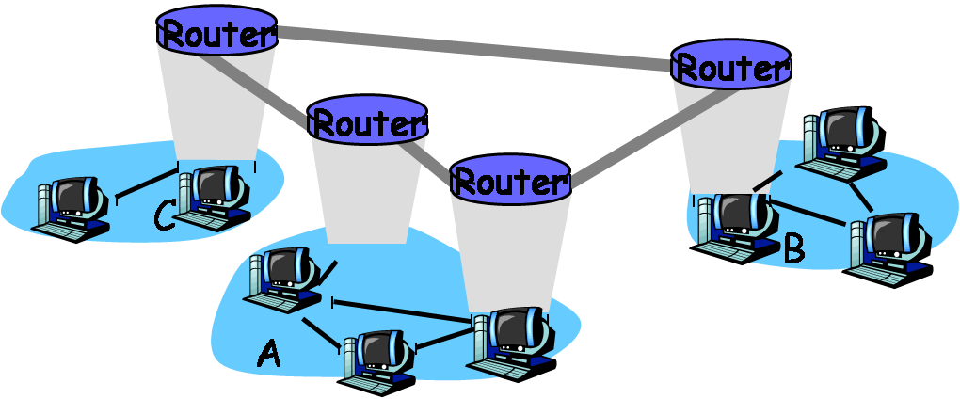
Motivations
Why Is Security Important?
Internet – Public network
– Build on TCP/IP
Store and Forward technology

Slide 4
Motivations
Protect digital assets?
Data and software
What is data?
Any object that can be processed or executed by a computer
Two states of data
transmission state
storage state
Data vs. information security
Harward and devices
Reputation

Slide 5
Motivations
Security goals?
Confidentiality
including data in transmission and storage states
Data integrity
including data in transmission and storage state
Non-repudiation
Authentication
All nodes in network
Privacy
Availability

Slide 6
Motivations
Countermeasure?
Loopholes, Flaws, and Defects
Defense: Who, Where, How?
Multiple-layer defense mechanism
Broader Scope
Data security
Information Security

Slide 7
Outline
Motivations
Threat, vulnerability, risk
Comment attacks
Protection, detection and response

Slide 8
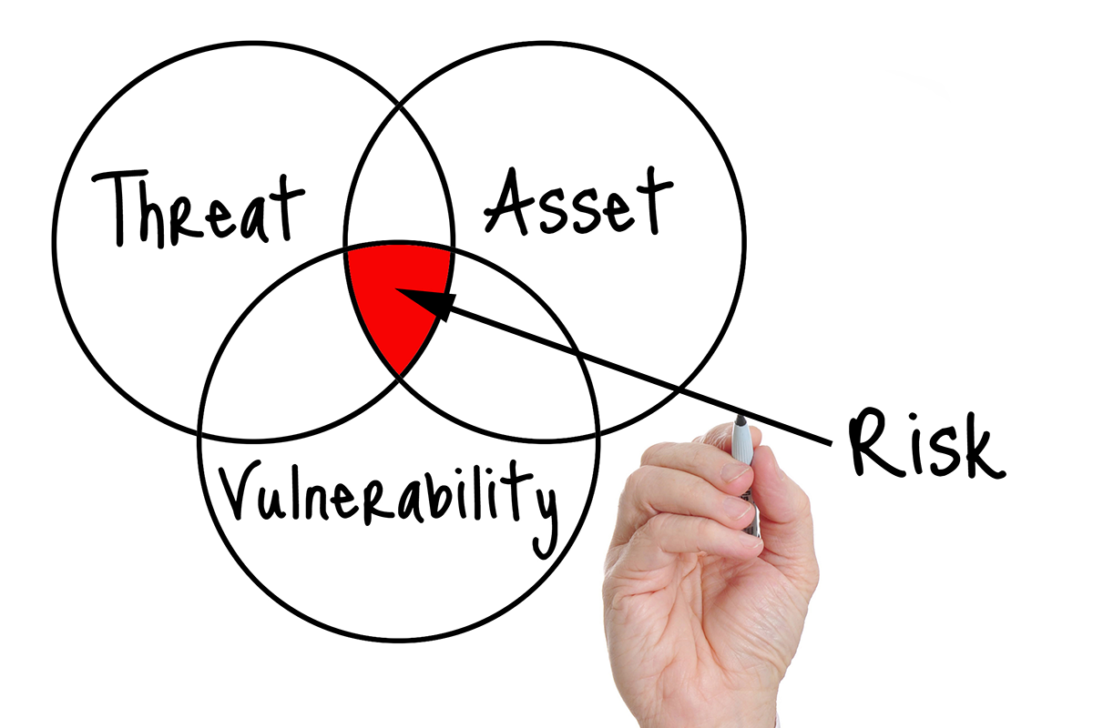
Vulnerability,Threats and Risks

Slide 9
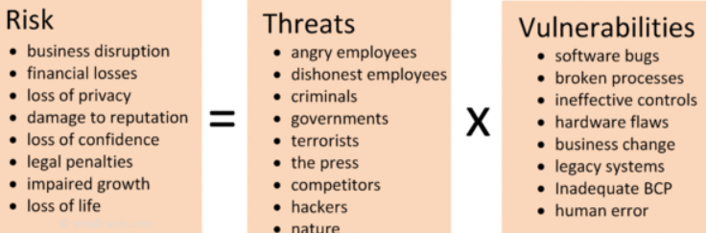

Risk
The term risk is used to describe the possibility of a threat taking advantage of an asset’s vulnerability
$X$ assests

Slide 10
Threats
Threats
Definition
Capabilities, intentions and attack methods of adversaries to exploit or cause harm to assets

Slide 11
Threat model
The individual, organization, or group
or actors

Slide 12
Threat agents
Definition
The individual, organization, or group that originates a particular threat action
Three types
Simple classification into MECE (mutually exclusive, collectively exhaustive) categories
External
Internal
Partners
Notes:
Originate = INITIATE = to create or start something

Slide 13
External agents
Definition
Agents outside the organization, with no direct links to the organization itself
Categories
Activist groups
Auditors
Competitors
Customers
Nature
Former employees
Government
Cybercrime

Slide 14
External agents (contd.)
Activist groups
Mix political activism with cybersecurity violations
E.g. Anonymous, Lulzsec
Governments
Chinese APT attacks
Mandiant report
Syrian attackers reported
Stuxnet

Slide 15
External agents (contd.)
Cybercrime
Nigerian 419 scam
Organized crime
Carder planet

Slide 16
Internal agents
Definition
People linked to the organization, often as employees
Categories
Internal auditors
Help desk
Upper management
Human resources
Janitorial staff
Software developers
System administrators

Slide 17
Internal agents (contd.)
Auditors
Can cause damage in the name of compliance
Upper management
Lack of awareness of information security concerns
May be reversing in the opposite direction
Often weakest link
Unaware of security
Force exemptions from policy

Slide 18
Partners
Definition
Third parties sharing a business relationship with the organization
Categories
Cloud service providers
Hardware and software vendors
Contractors

Slide 19
Threat actions
Definition
Activity performed by the agent in order to affect the confidentiality, integrity, or availability of the asset
New actions emerging all the time
Simple categories
Malware
Hacking
Social engineering
Physical
Error
Environment

Slide 20
Threat actions (contd.)
Malware
Malicious software
Viruses
Worms
Bots
Hacking
Brute force
Poor choice of passwords
Default passwords
Cross-site scripting
Most important threat action
Eric Grosse, VP, Security Engg. @ Google, NSF meeting 2012
SQL injection
Misuse of privileges

Slide 21
Threat actions (contd.)
Social engineering
Unapproved software
Phishing
Pre-texting
Physical
Unauthorized access
Theft
Error
Mis-configuration
Environment
Power and equipment outages
Natural events

Slide 22
Vulnerabilities
Definition
Weaknesses in information systems that gives threats the opportunity to compromise assets
Relationship with threats
Vulnerability is not a risk without a threat exploiting it
Threat is not a risk without a vulnerability to be exploited

Slide 23
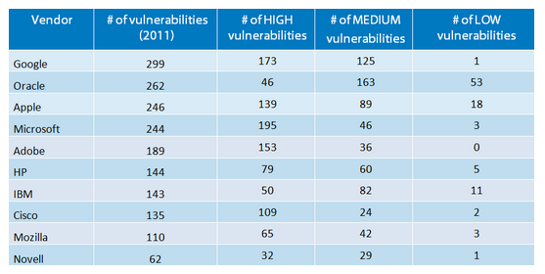
Vulnerabilities

Slide 24
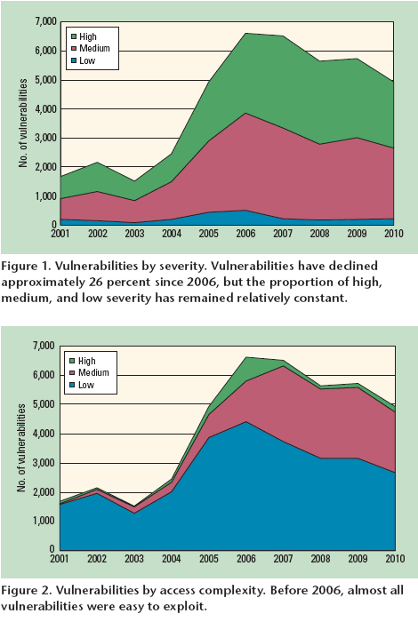
Vulnerability trends
Source:
Kuhn and Johnson, Vulnerability trends: measuring progress, IEEE IT Pro, 12(4), pg. 51-53, 2010
Kuhn, R., Raunak, M., & Kacker, R. (2017). It doesn’t have to be like this: cybersecurity vulnerability trends. IT professional, 19(6), 66-70.

Slide 25
Vulnerability categories
Operating system vulnerabilities
Patch Tuesday https://www.helpnetsecurity.com/2022/03/08/march-2022-patch-tuesday/
Application vulnerabilities
OWASP top 10 list
https://owasp.org/www-project-top-ten/
NATIONAL VULNERABILITY DATABASE
https://nvd.nist.gov/vuln/categories
Hardware/Appliances
https://www.cvedetails.com/product-list/product_type-h/vendor_id-0/firstchar-F/Hardwares.html

Slide 26
IT SECURITY RISKS
Risks:
unauthorised use of a system;
unauthorised removal or copying of data or code from a system;
damage to or destruction of physical system assets and environment;
damage to or destruction of data or code inside or outside the system;
naturally occurring risks.

Slide 27
Outline
Motivations
Threat, vulnerability, risk
Comment attacks
Passive attacks
Active attacks
Protection, detection and response

Slide 28
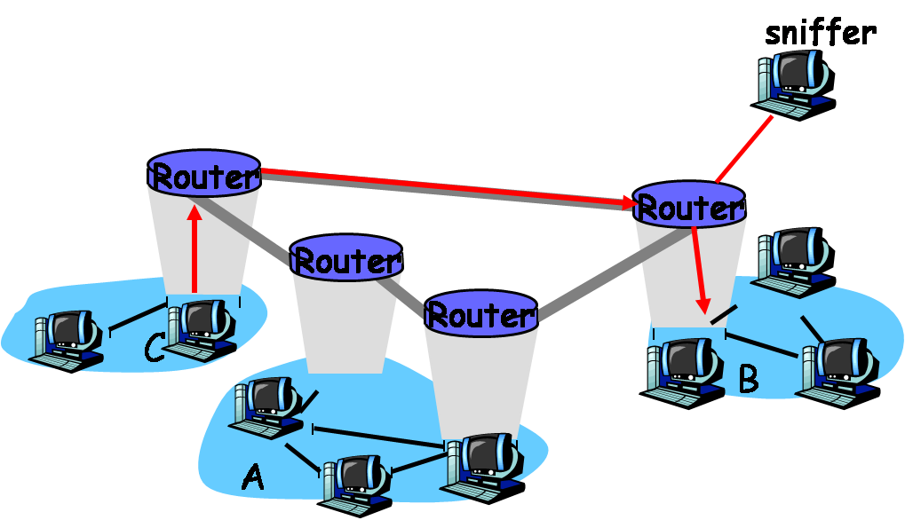
Passive attacks
Eavesdropping
Common packet sniffers: TCP dump, Wireshark
Solution - Encrypt Data

Slide 29
Cryptanalysis
Cryptanalysis
Find useful information from plaintext, ciphertext data
e.g. analyzing statistical structure
Defense method
Use longer keys and stronger encryption algorithms

Slide 30
Sensitive information Pilfering
Authentication information: password, OTP,
Biometric, challenge question,…
Password Pilfering (stolen)
Password protection is often the first defense line, which may be the only defense available in the system
Methods to pilfer user password:
Guessing
Social engineering
Dictionary attacks
Password sniffing
Notes:
Steal = pilfer;

Slide 31
Guessing
Easiest, particularly on short or default passwords
Most commonly-used passwords (ref. SpashData):
123456
password
12345678
qwerty (which are keys below 123456 on standard keyboard
abc123
123456789
111111
1234567
Iloveyou
adobe123

Slide 32
Social Engineering (1/3)
Methods of using social skills to pilfer secret information
Physical Impersonation
The attacker pretends to be a different person to delude the victim
(See example on page 6 from textbook)
Phishing
The most common form of mass social engineering attacks in recent years
Disguised email messages or masquerade web sites
See the next slide for a real phishing example verbatim (note the typos in the phishing email), where the link in the email is a trap

Slide 33
Social Engineering (2/3)
Date: Fri, 5 Oct 2007 16:11:46 -0700
From: US Bank SCD-Verify@usbank.com
Subject: US Bank – Internet Online Access is Locked – October 5, 2007 at 12:23:05 PM
Dear US Bank Customer,
We’re sorry, but you reached the maximum number of attempts allowed to login into your US Bank account. For your protection, we have locked your account.
Consequently, we placed a temporary restriction on your account. We did this to protect your account from any fraudulent activity.
Please click below and complete the steps to Remove Limitations. This allows us to confirm your identity and unlock your US Bank online account
http://www4-usbank.com/
If we do no receive the appropriate account verification within 48 hours, then we will assume this US Bank account is fraudulent and will be suspented.
US Bank, Member FDIC. @2007 US Bank Corporation. All Rights Reserved.

Slide 34
Social Engineering(3/3)
In general, any phishing email would contain a link to a bogus Web site, called a phishing site
Other forms
Collect recycled papers from recycling bins
Web browser pop up a window asking for user login
Defense Method – Anti-phishing extensions of web browsers are emerging technology for detecting and blocking phishing sites

Slide 35
Dictionary Attacks
Only encrypted passwords should be stored in a computer system
in UNIX/Linux
passwords are stored in a file named shadows under directory /etc
in Windows XP
passwords are stored in a file named SAM, which is stored in the system’s registry;
Web database
Store in user tables
Applications
Somewhere in the host

Slide 36
Dictionary Attacks
A typical dictionary attack proceeds as follows:
Obtain information of user names and the corresponding encrypted passwords
Run the encryption routine used by the underlying system on all dictionary words, names, and dates
Compare each output obtained from step 2 with the encrypted passwords obtained from step 1. If a match presents, a user password is found
Constructing a Rainbow table helps to reduce the table size and make the computation manageable

Slide 37
Rainbow Table
r is a reduction function.
h is a cryptographic hash function
w₁₁ is a given password. Apply h and r alternatively to obtain a chain of passwords that are different pairwise:
Where, w_{1i} = r(h(w_{1,i-1} ), i = 2,3,…,n₁ and store (w₁₁, h(w_{1n1}))
Password | Hash value
w₁₁ w₂₁ … w_{k1} | h(w_{1 n1}) h(w_{2 n2}) … h(w_{k nk})
Repeat this procedure k times generating k rows in the rainbow table

Slide 38


Rainbow Table
Let f: A→B and g: B→A be two functions. Let y∈ B and i ≥ 0.
Define:
Let Q₀ be an encrypted value of a password w. That is, Q₀ = h(w). If
for some i ≥ 0 and some j with 1 ≤ j ≤ k and i ≤ j, then w is possible to appear in the jth chain of w_{j1},…w_{j,nj} .

Slide 39
Rainbow Table
Algorithm to find w in a rainbow table:
Set Q₁ ← Q₀ and t ← 0. Let n = max{n₁,…,n_{k}}
Check if there is a 1 ≤ j ≤ k such that Q₁ = h(w_{j,nj}) and t ≤ n. If yes, goto step 3; otherwise, goto step 4
Apply r and h alternatively on w_{j1} for 0 ≤ i ≤ j times until
w_{j,ni} = (r ○ h)^{i}(w_{j1}) is generated such that h(w_{j,ni}) = Q₀ . If such a w_{j,ni} is found, return w = w_{j,ni}; otherwise, goto step 4
Set Q₁ ← h(r(Q₁)) and t ← t + 1. If t ≤ n then goto step 2. Otherwise, return “password not found.” (the rainbow table doesn’t contain the password whose hash value equals Q₀ )

Slide 40
Active attacks
Password Sniffing
Password sniffers are software programs, used to capture remote login information such as user names and user passwords
Defense Method – encrypt all message, include login information, using, e.g., SSH and HTTPS
Cain & Abel, a password recovery tool, can capture and crack encrypted password for the Microsoft Operating System

Slide 41
Password Protection
Rules to help protect passwords from pilfering:
Use long passwords, with a combination of letters, capital letters, digits, and other characters such as $,#,@. Do not use dictionary words, common names and dates.
Do not reveal your passwords to anyone you do not know. Do not submit to anyone who acts as if he has authority. If you have to give out your password, do so face to face.
Change passwords periodically and do not reuse old passwords.
Do not use the same password for different accounts.
Do not use remote login software that does not encrypt user passwords and other important personal information.
Shred all discarded papers using a good paper shredder.
Avoid entering any information in any popup window, and avoid clicking on links in suspicious emails.

Slide 42
Other User-Authentication Methods
Use biometrics of unique biological features – connect biometric devices to a computer, such as fingerprint readers and retina scanners
User devices
Use authenticating items – electronic passes authenticated by the issuer (smart card).
Authentication using user passwords is by far the easiest method

Slide 43
Identity Spoofing
Active attacks
Spoofing is a specific type of cyber-attack in which someone attempts to use a computer, device, or network to trick other computer networks by masquerading as a legitimate entity
Identity Spoofing = impersonation attack
Notes:
Spoofing =

Slide 44
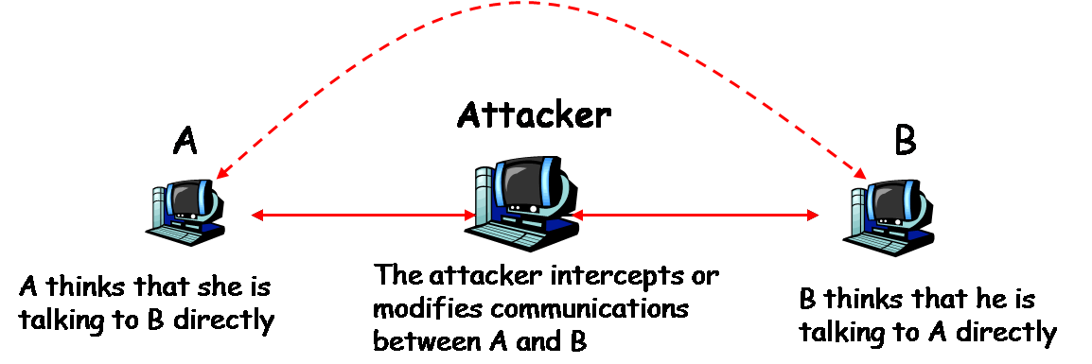
Man-in-the-middle Attacks
Compromise a network device (or installs one of his own) between two or more users. Using this device to intercept, modify, or fabricate data transmitted between users.
Defense measures – encrypting and authenticating IP packets

Slide 45
Message Replays
The attacker first intercepts a legitimate message and retransmits it at a later time to the original receiver
For example, an attacker may intercept an authentication pass of a legitimate user, and use it to impersonate this user to get the services from the system
Defense Mechanisms –
Attach a random number to the message. This number is referred to as nonce (it requires to store the entire history)
Attach a time stamp to the message (it is impossible to synchronize networked computers 100%; there will be a small error of time)
The best method is to use a nonce and a time stamp together (only store the messages within a small time interval [t, t+Δt])

Slide 46
Active attacks
Network Spoofing
IP spoofing is one of the major network spoofing techniques
https://en.wikipedia.org/wiki/IP_address_spoofing
SYN flooding
The attacker fills the target computer’s TCP buffer with a large number of crafted SYN packets
Purpose: Make the target computer unable to establish connection (i.e., to silent/mute the computer)
ARP spoofing, which is also known as ARP poisoning

Slide 47
Active attacks
SYN flooding
Attacker sends to victim a large number of crafted SYN packets
The victim’s computer is obliged to send an ACK packet to the crafted source IP address contained in the SYN packet according to the 3-way handshake protocol
Because the source IP address is crafted and unreachable, the victim computer will never receive the ACK packet it is waiting for, allowing the crafted SYN packet to remain in the TCP buffer
The TCP buffer is completely occupied by the crafted SYN packets, causing the computer unable to establish communications with other computers

Slide 48
Active attacks
TCP Hijacking
V is a company computer
Alice, an employee of the company, is going to remote logon to V
Alice sends a SYN packet to V
The attacker intercepts this packet, and uses SYN flooding to mute V so that V can’t complete the three-way handshake
The attacker predicts the correct TCP sequence number for the ACK supposed to be sent from V to Alice. The attacker then crafts an ACK packet with the sequence number and V’s IP address and sends it to Alice
Alice verifies the ACK packet and sends an ACK packet to the attacker to complete this handshake
The TCP connection is established between Alice and the attacker, instead of between Alice and V.

Slide 49
Active attacks
ARP Spoofing
The attacker changes the legitimate MAC address of a networked computer to a different MAC address chosen by the attacker
Defense Method – checking
Check MAC address and domain names

Slide 50
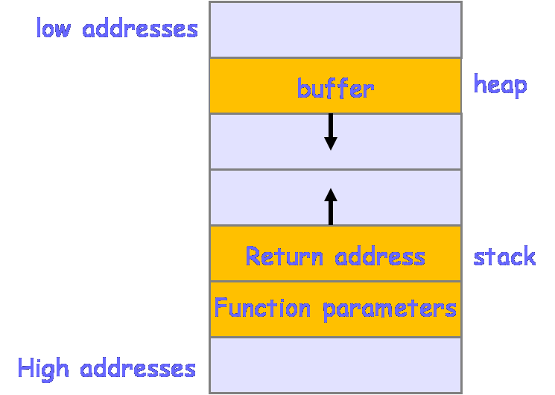
Buffer-Overflow Exploitation
Buffer-Overflow Exploitation
Buffer overflow, a.k.a. buffer overrun, is a common software flaw. Buffer overflow occurs if the process writes more data into a buffer area than it is supposed to hold
It is possible to exploit buffer overflows to redirect the victim’s program to execute attackers’ own code located in a different location. Such attacks often exploit function calls in standard memory layout, where the buffer is placed in a heap and the return address of the function call is placed in a stack

Slide 51
Buffer-Overflow Exploitation
General steps of buffer-overflow attack:
Find a program that is prone to buffer overflows (e.g. programs use function do not check bounds)
Figure out the address of the attacker’s code
Determine the number of bytes that is long enough to overwrite the return address
Overflow the buffer that rewrites the original return address of the function call with the address of the attacker’s code
Defense method
Coding: follow good programming practice; always add statements to check bounds when dealing with buffers
Compiling: insert a random canary value before a returned address

Slide 52
Repudiation
In some situations the owner of the data may not want to admit ownership of the data to evade legal consequences
He may argue that he has never sent or received the data in question
Defense method –
Use stronger encryption and authentication algorithms

Slide 53
Intrusion
An illegitimate user gains access to someone else’s computer systems. Configuration loopholes, protocol flaws, and software side effects may all be exploited by intruders
Intrusion detection is a technology for detecting intrusion incidents. Closing TCP and UDP ports that may be exploited by intruders can also help reduce intrusions
IP scans and Port scans are common hacking tools. However, it can also help users to identify in their own systems which ports are open and which ports may be vulnerable.

Slide 54
Traffic Analysis
The purpose is to determine who is talking to whom by analyzing IP packets. Even if the payload of the IP packet is encrypted, the attacker may still obtain useful information from analyzing IP headers
Defense method – Encrypt IP headers. But an IP packet with an encrypted IP header cannot be routed to destination. Thus, network gateways are needed
Network gateway also protects internal network topology

Slide 55
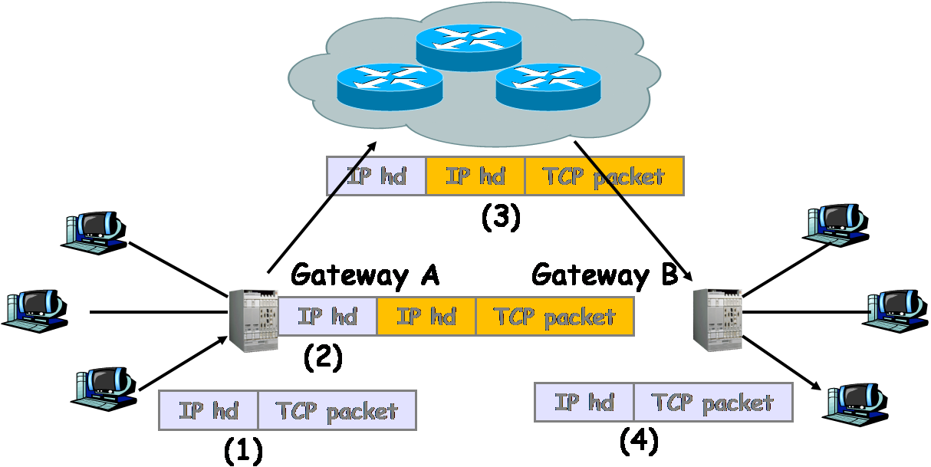
Traffic Analysis
(1) Sender forwards an IP packet to gateway A. (2) gateway A encrypts sender’s IP packet and routes it to the next router in the Internet. (3) The IP packet from Gateway A is delivered to gateway B. (4) Gateway B removes its header, decrypts the encrypted IP packet of the sender, and forwards it to the receiver.

Slide 56
Denial of Service Attacks
The goal is to block legitimate users from getting services they can normally get from servers
DoS – launched from a single computer
DDoS – launched from a group of computers

Slide 57
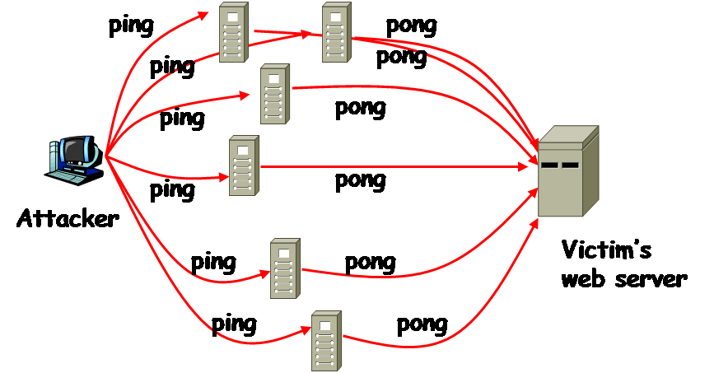
DoS
SYN flooding is a typical and effective technique used by DoS attacks. The smurf attack is another typical type of DoS attack
Attacker sends an excessive number of crafted ping requests to a large number of computers within a short period of time, where the source IP address in the crafted ping request is replaced with the victim’s IP address. Therefore, each computer that receives the crafted ping request will respond to the victim’s computer with a pong message.

Slide 58
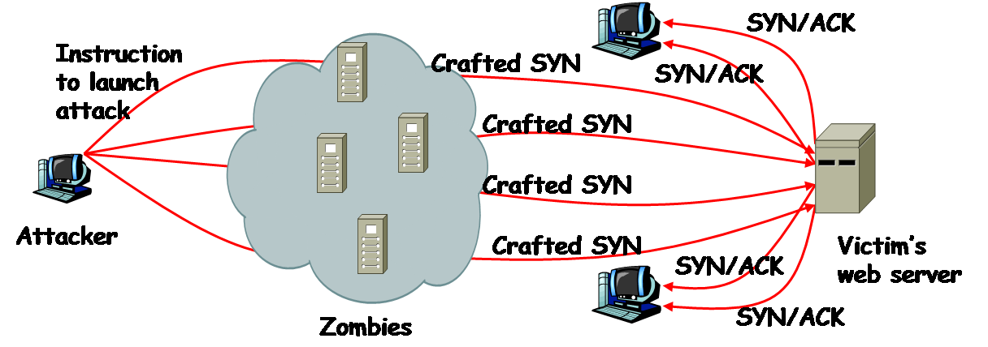
DDoS
A typical DDoS attack proceeds as follows:
Compromise as many networked computers as possible
Install special software in the compromised computers to carry out a DoS attack at a certain time later
Issue an attack command to every zombie computer to launch a DoS attack on the same target at the same time

Slide 59
Spam Mail
Spam mails are uninvited email messages, which may be commercial messages or phishing messages
While not intended to bring the user’s computer out of service, spam mails do consume computing resources
Spamming also occurs in Web search engines, Instant Messaging, blogs, mobile phone messaging, and other network applications
Defense method – spam fillers are software solutions to detect and block spam mails from reaching the user’s mailbox

Slide 60
Malicious Software
Software intended to harm computers is malicious software. Malicious software is also referred to as malware
Virus
Worms
Trojan horses
Logic bombs
Backdoors
Spyware

Slide 61
Malicious Software
Viruses and Worms
A computer virus is a piece of software that can reproduce itself. A virus is not a standalone program. It must attach itself to another program or another file. A program or file that contains a virus is called an infected host
A computer worm is also a piece of software that can reproduce itself. Unlike a virus, a worm is a stand alone program.
Defense method –
Do not download software from distrusted Web sites or other sources
Do not open any executable file given to you by someone you do not know
Make sure software patches are installed and up to date

Slide 62
Malicious Software
Trojan Horse
Trojan horses are software programs that appear to do one thing, but secretly also perform other tasks
Trojan horses often disguise themselves as desirable and harmless software applications to lure people to download them
Defense method – The same measures of combating viruses and worms can also be used to combat Trojan horses. Virus scans can also detect, quarantine, and delete Trojan horses

Slide 63
Malicious Software
Logic Bombs
Logic bombs are subroutines or instructions embedded in a program. Their execution are triggered by conditional statements
Defense method –
Employers should take care of their employees, so that none would be tempted to place a logic bomb
Project managers should hire an outside company or form a special team of reviewers from a different group of people other than the developer to review the source code
Relevant laws should be established so that employees who planted logic bombs will face criminal charges

Slide 64
Malicious Software
Backdoors
Backdoors are secret entrance points to a program
They may be inserted by software developers to provide a short cut to enter a password-protected program when attempting to modify or debug code
Defense method – check source code by an independent team

Slide 65
Malicious Software
Spyware
Spyware is a type of software that installs itself on the user’s computer
Spyware is often used to monitor what users do and to harass them with popup commercial messages
Browser Hijacking – is a technique that changes the settings of the user’s browsers
Zombieware – software that takes over the user’s computer and turns it into a zombie for launching DDoS attacks or into a relay which carries out harmful activities such as sending spam email or spreading viruses.

Slide 66
Malicious Software
Spyward can also do a list of other things, including
Monitoring – monitor and report to a web server or to the attacker’s machine a user’s surfing habits and patterns.
Password sniffing – sniff user passwords by logging users’ keystrokes using a keystroke logger
Adware – software that automatically displays advertising materials on the user’s computer screen.
Defense method – use anti-spyware software to detect and block spyware

Slide 67
Outline
Motivations
Threat, vulnerability, risk
Comment attacks
Passive attacks
Active attacks
Protection, detection and response
Basic Security Model

Slide 68
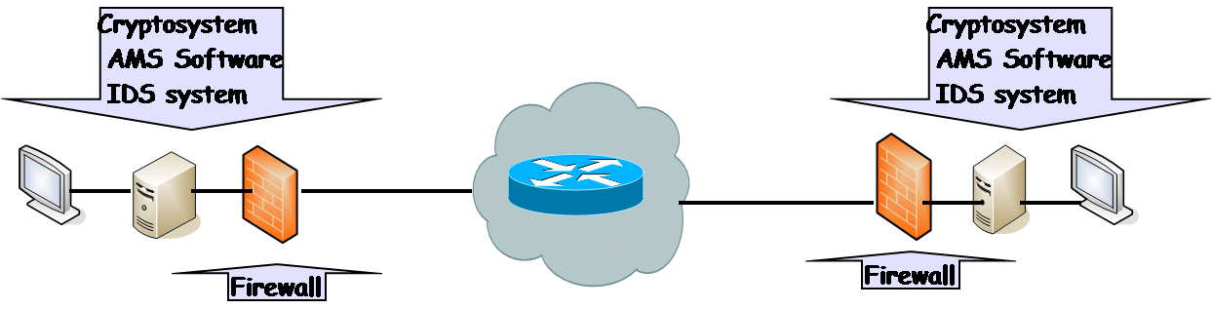
Basic Security Model
The basic security model consists of four components: cryptosystems, firewalls, anti-malicious-software systems (AMS software), and intrusion detection system (IDS)
Notes:
IDS= Intrusion detection system (phat hien sam nhap)

Slide 69
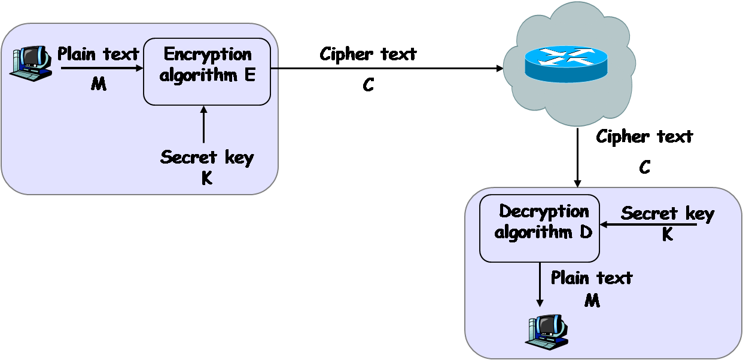
Network model of cryptosystem cipher

